Slide 1
The History of DNA Sequencing
Sequencing and Bioinformatics Training
KEMRI-HQ, Nairobi
Happiness Kumburu,PhD.
March, 2024

Slide 2
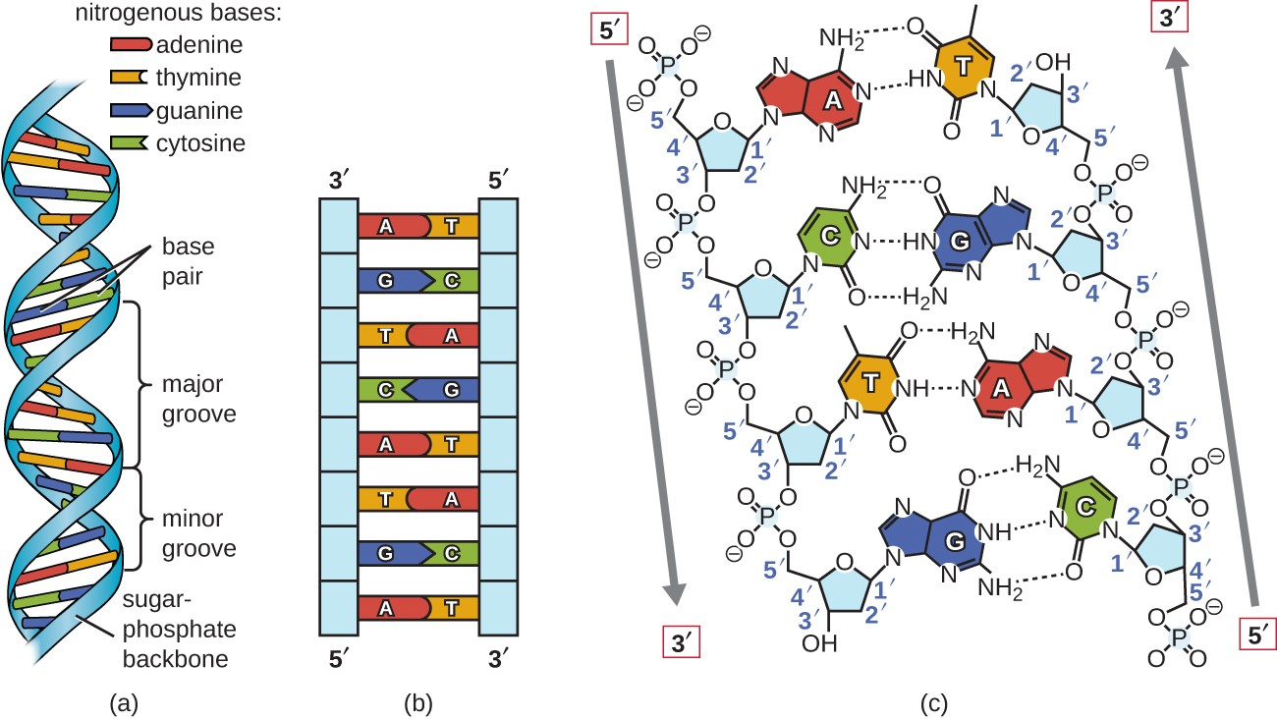
DNA sequencing

Slide 3
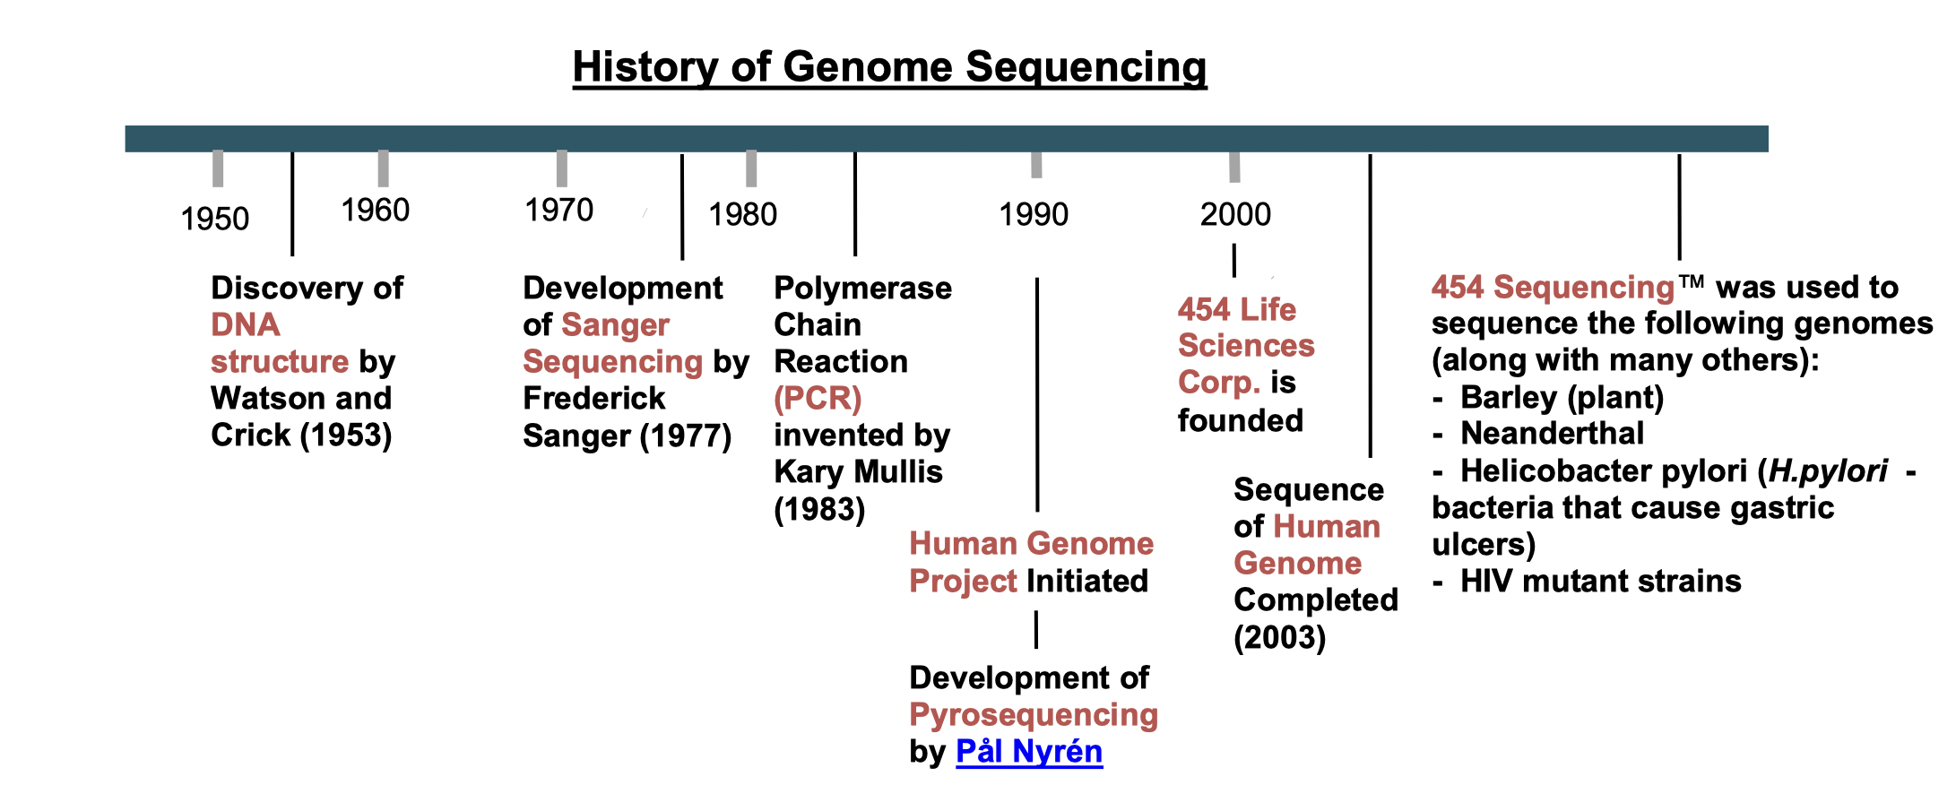

Slide 4
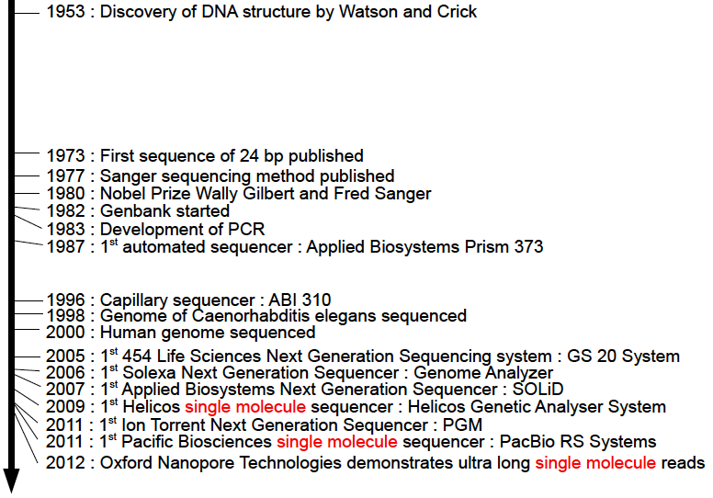

Slide 5
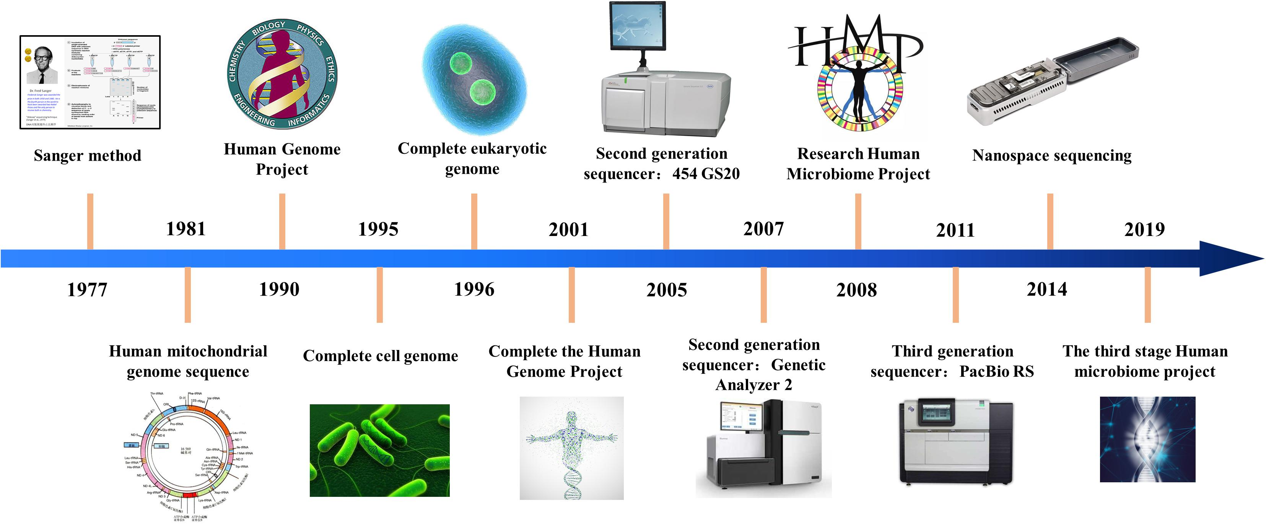
Generations of sequencing technologies

Slide 6
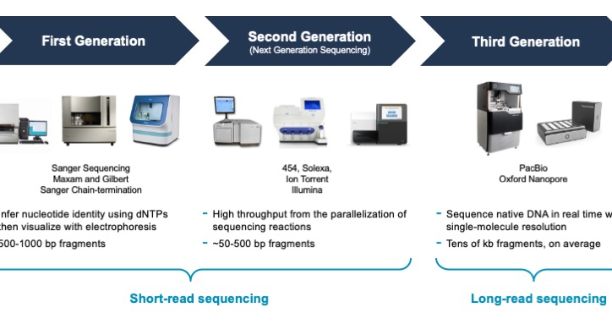

Slide 7
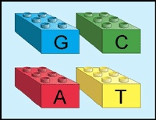
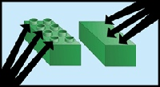
First Generation Sequencing-Sanger Sequencing
Fred Sanger: Nobel Prize 1980
• Instead of taking a complete sequence and breaking it down, build DNA sequences up and analyze steps along the way
• The key to this process: dideoxynucleotides (ddNTPs)
Normal LEGOs have little pegs that allow them to stack
Faulty LEGOs lack the little pegs and nothing can stack on them – thus, they ‘terminate’ the stack
Notes:
Developed by Frederick Sanger in the late 1970s.
Revolutionized molecular biology and enabled the Human Genome Project.
Sequences DNA fragments individually, often limited to several hundred base pairs per read.
Still used for certain applications, especially in smaller-scale projects and validation studies

Slide 8
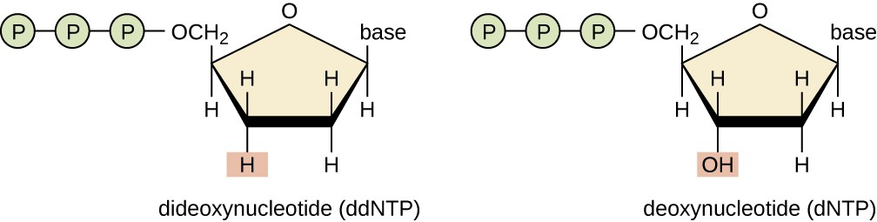

Slide 9
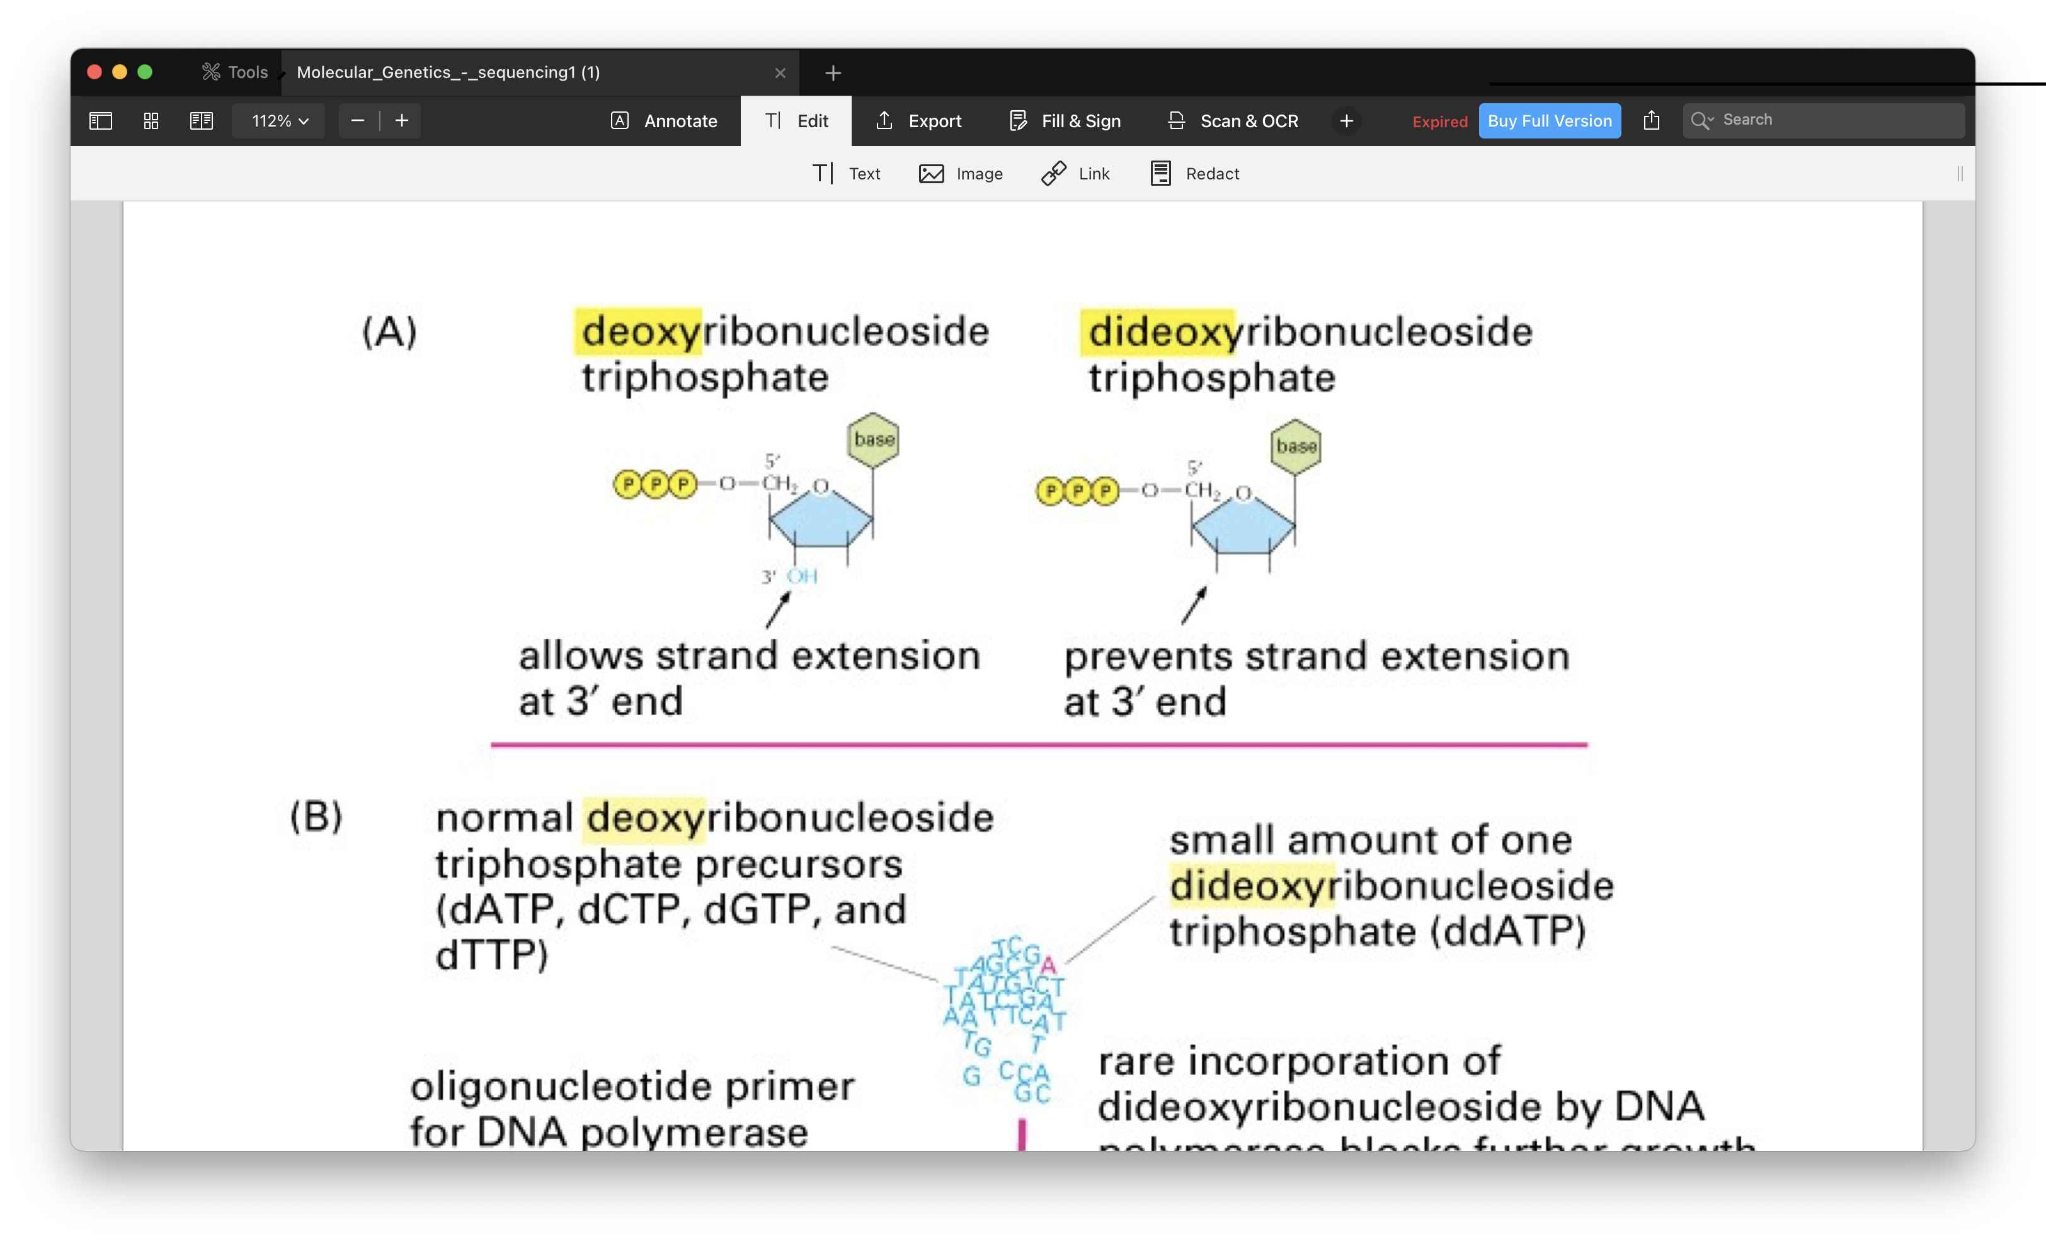

Slide 10
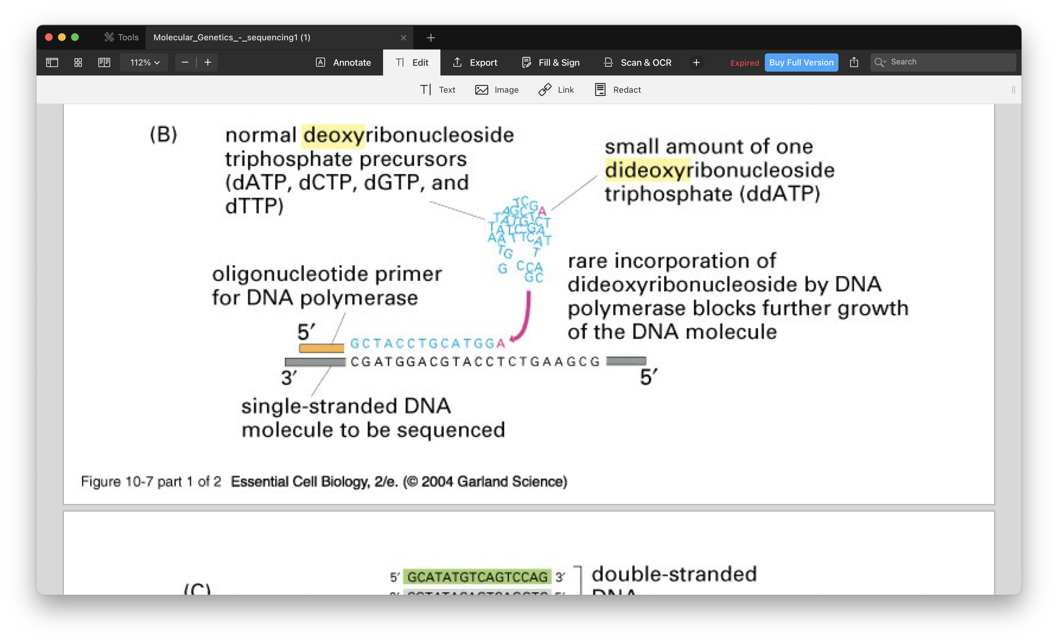

Slide 11
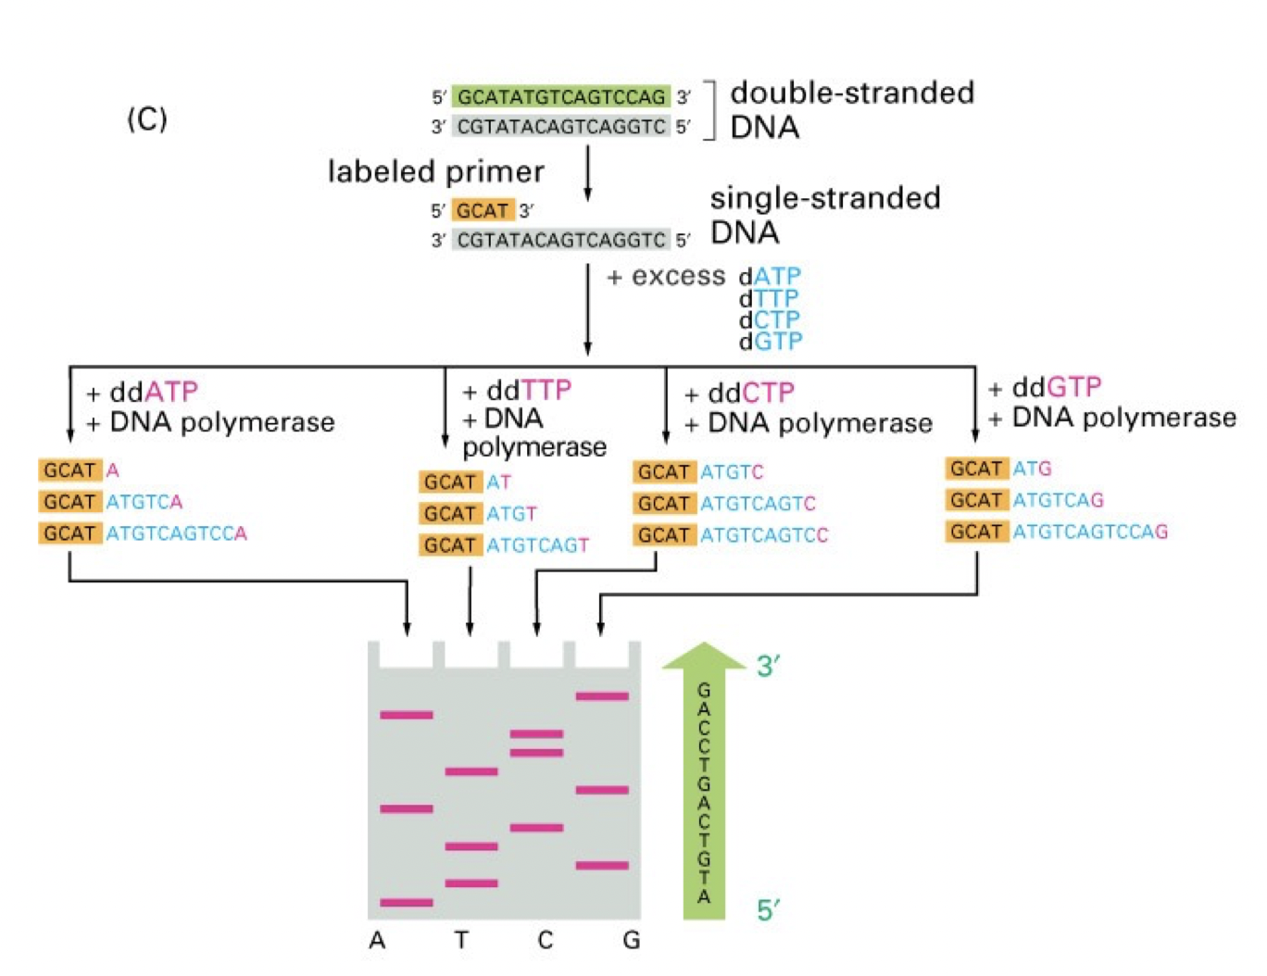

Slide 12
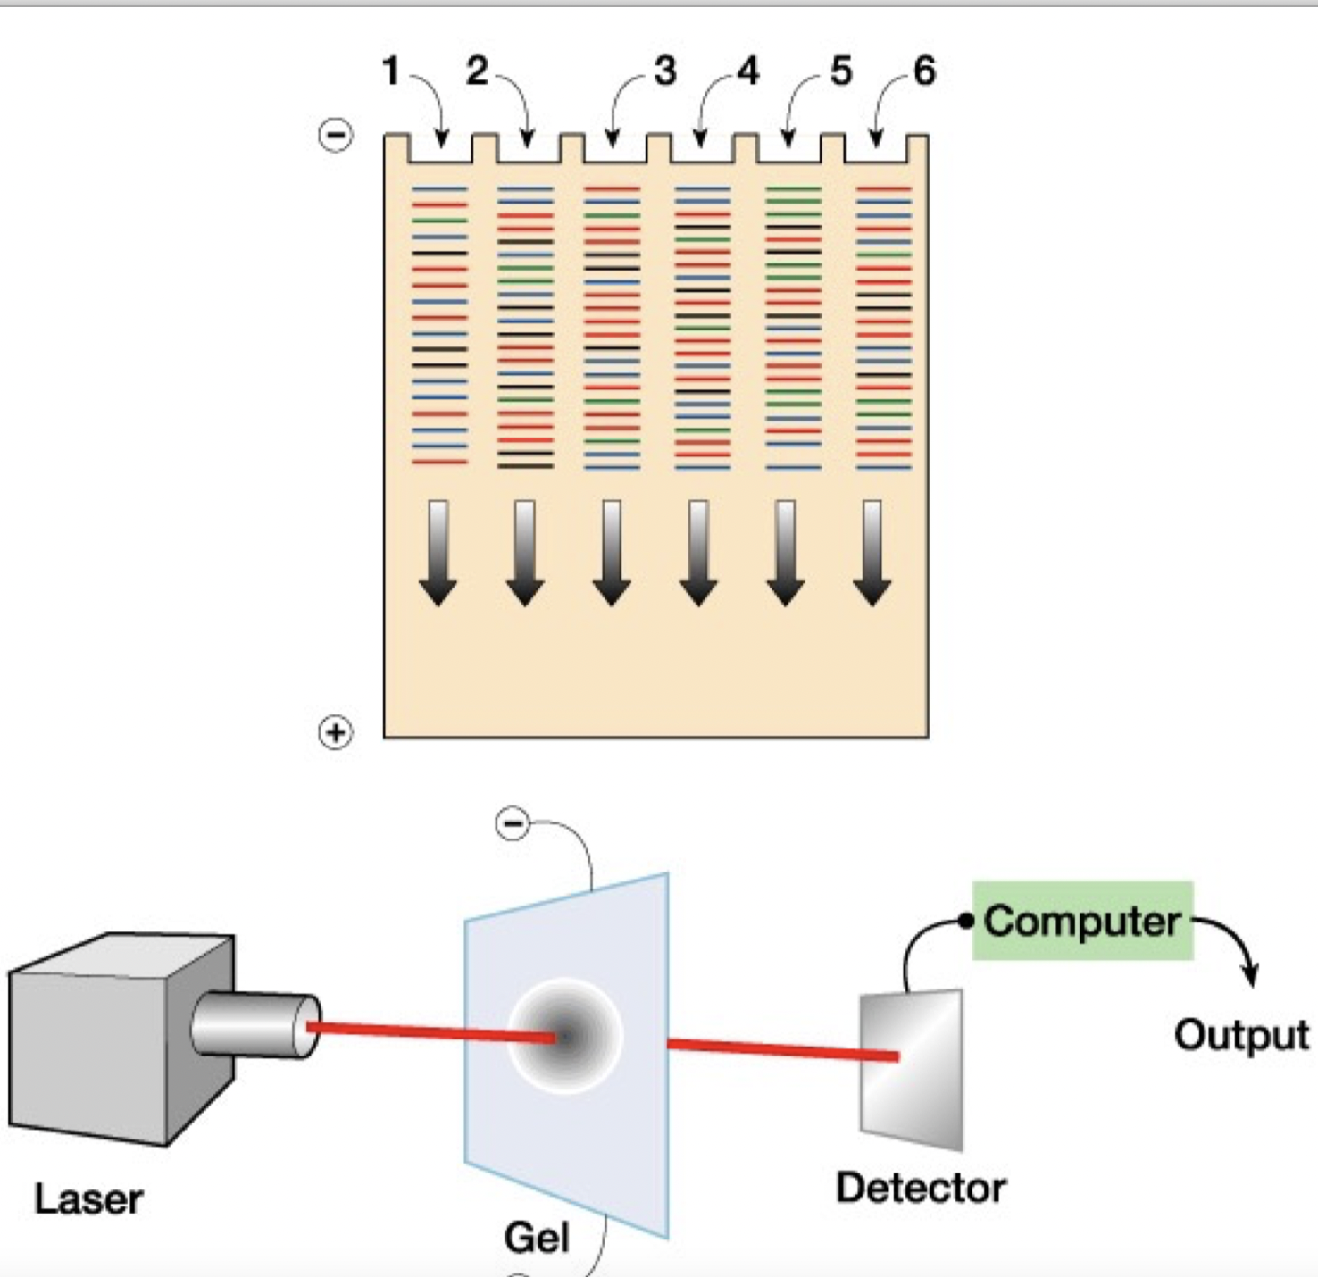

Slide 13
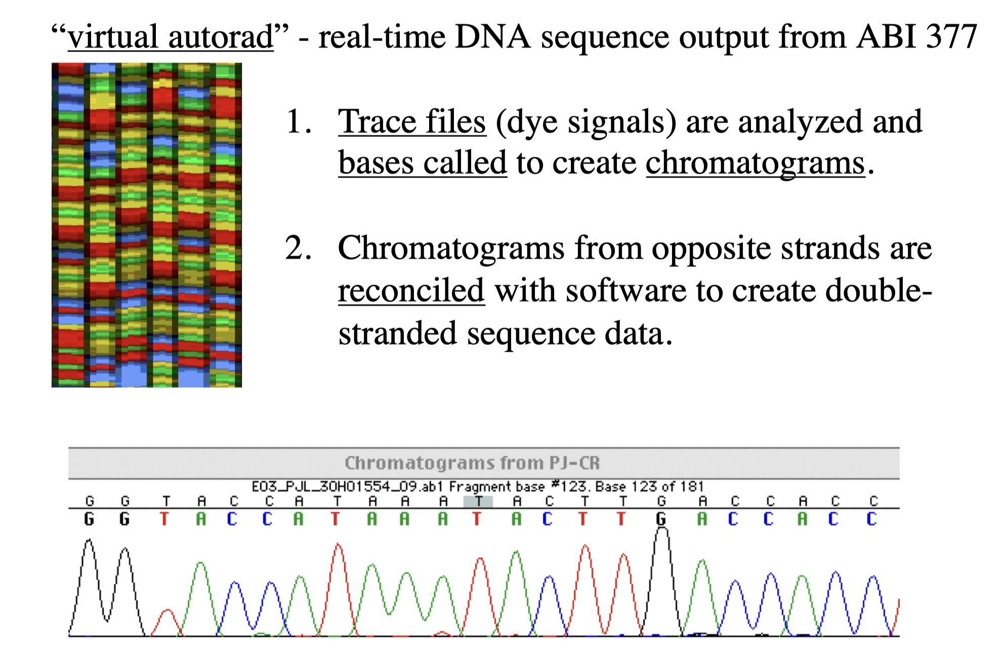

Slide 14
Next generation sequencing (NGS)
NGS, also known as high-throughput sequencing, refers to a set of massively parallel sequencing technologies that have revolutionized DNA sequencing over the past two decades.
These methods enable the rapid and cost-effective generation of large volumes of DNA sequence data compared to traditional Sanger sequencing.
NGS platforms have significantly advanced our ability to study genomics, genetics, molecular biology, and various other fields.

Slide 15
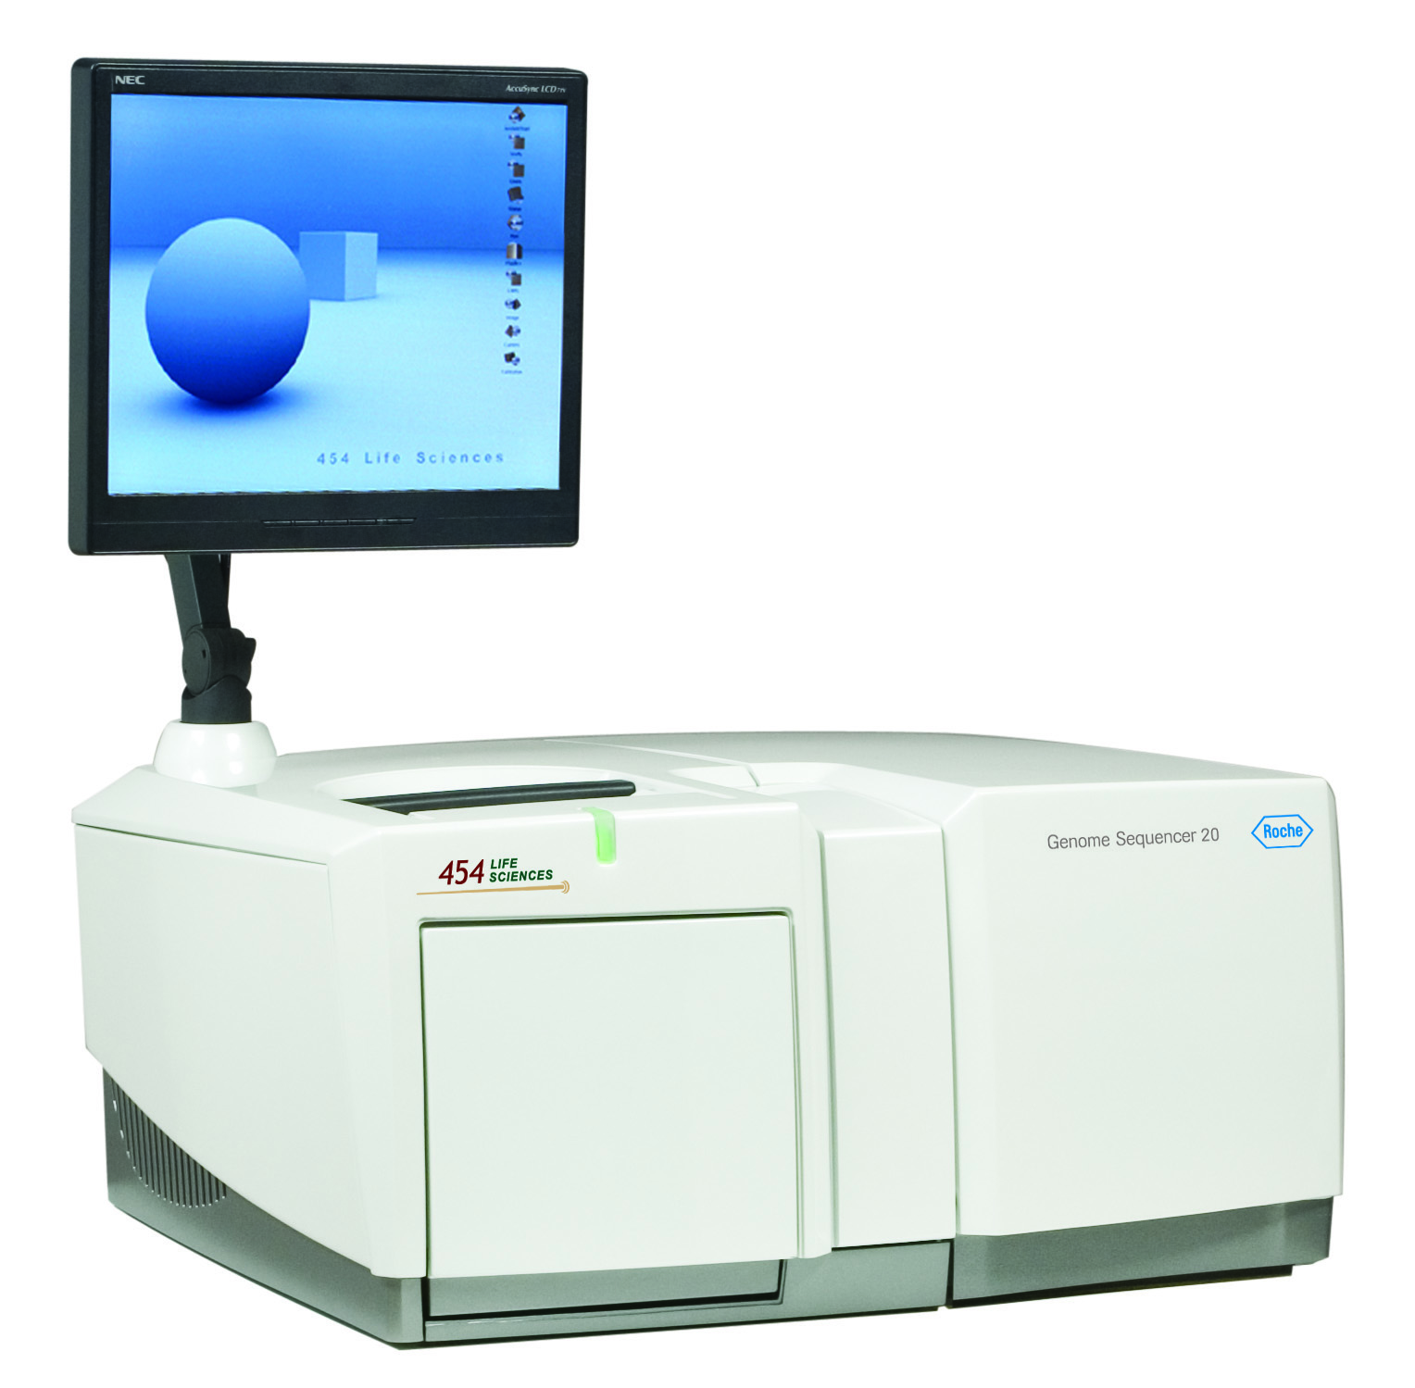
2005
Next Generation Sequencing
real-time detection of nucleotide incorporations during DNA synthesis through the measurement of the light signal generated by the conversion of pyrophosphate (PPi) to ATP and subsequent light emission reactions
454 Life Sciences: Parallelized pyrosequencing
Reduce costs 6 fold
Notes:
454 Life Sciences markets a parallelized version of pyrosequencing.
The first version of their machine reduced sequencing costs 6-fold compared to automated Sanger sequencing.

Slide 16

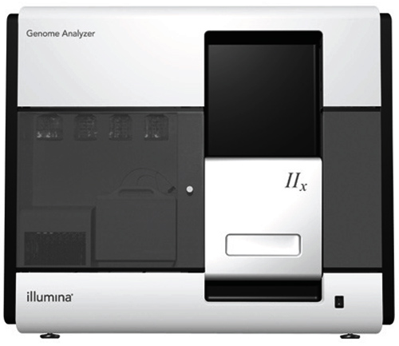
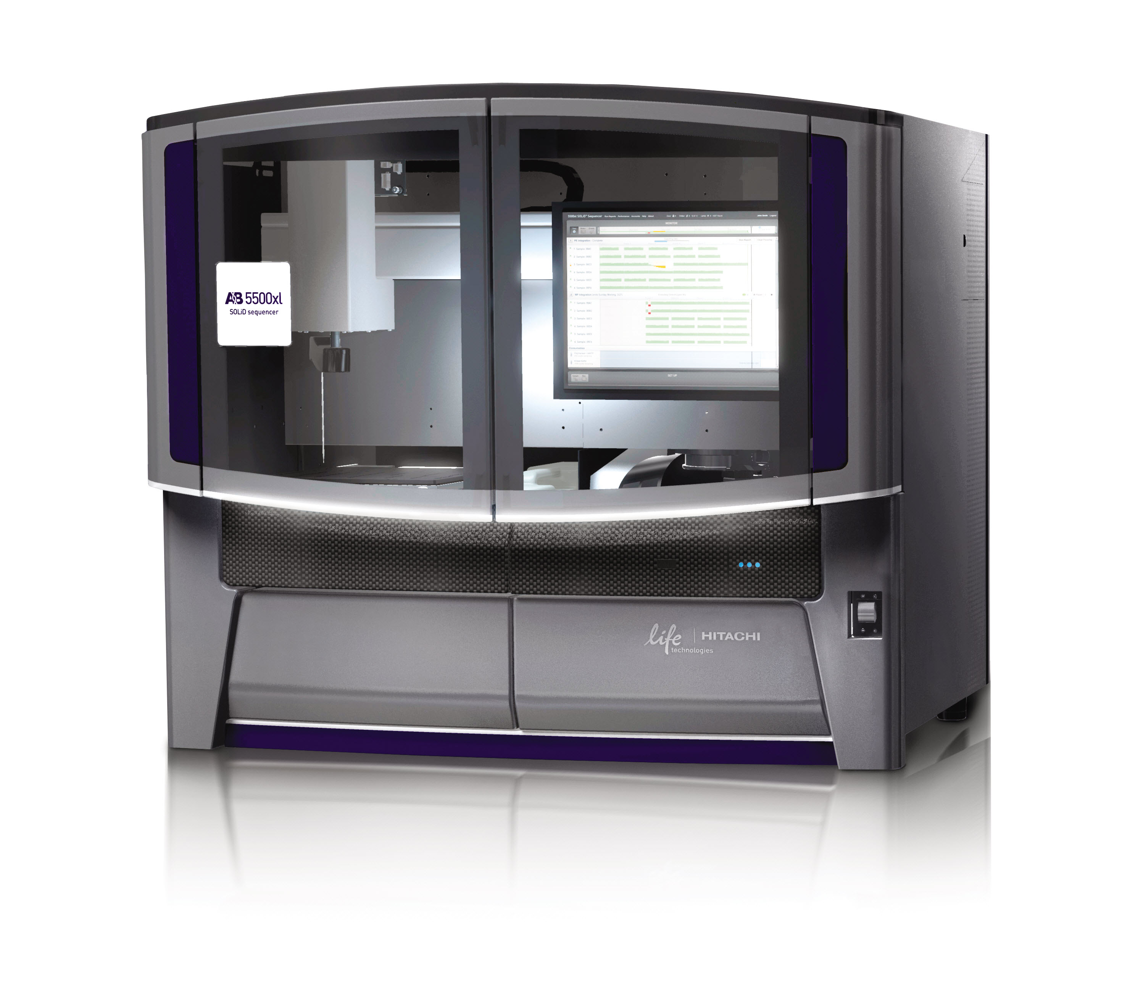
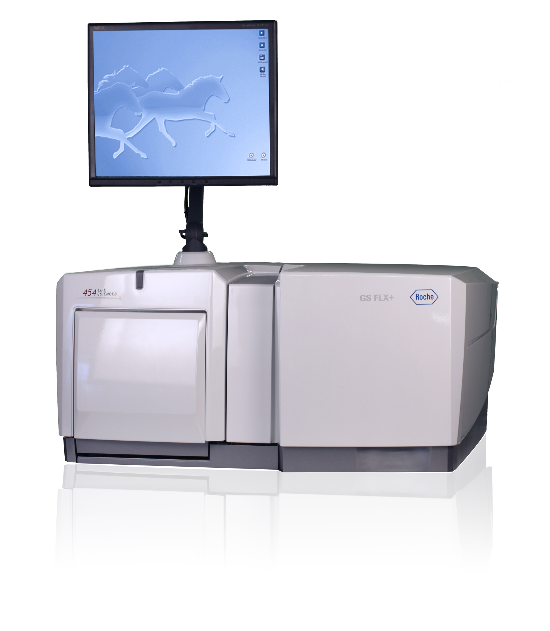
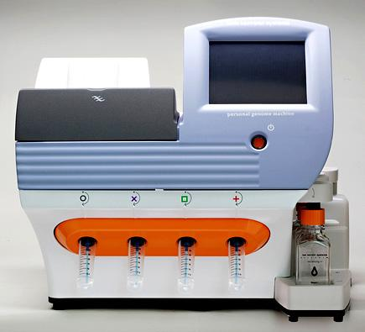
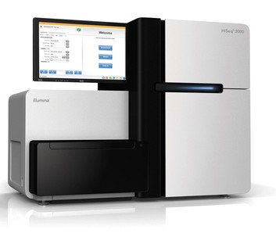
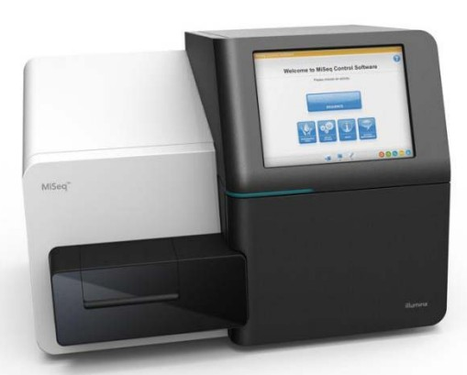
Next generation sequencing
Method outline - library
Amplification primer
1. Fragment DNA
2. Ligate adapters
Barcode
3. Amplification
Sequencing primer
4. Sequencing
Notes:
----- Meeting Notes (10/2/13 09:07) -----
1. A library of fragment targets is created...
2. Adapters containing universal priming sites are ligated to the target ends.
3. Thise adapters consist of a amplification primer, to amplify the fragments, a sequence primer which is used to sequence the fragments and if your are sequecing more than one isolate/sample the adapter will also contain a barcode which is specifik for each sample.
4. Finally the fragments are amplified and sequenced by one of the NGS mashines…

Slide 17
Next generation sequencing
Illumina
Genome Analyzer
HiSeq
MiSeq
Short reads (~100-300 bp)
Good Accuracy
High Throughput
Notes:
Illumina:
The most widely used next-generation sequencer on the market and have three
To determine the sequence, four types of reversible terminator bases are added and non-incorporated nucleotides are washed away. A camera takes images of the fluorescently labeled nucleotides, then the dye is chemically removed from the DNA, allowing for the next cycle to begin.
Advantages: Good accuracy and high throughput
Disadvantages: Short reads, long run time,

Slide 18
Illumina sequencing technology
https://www.youtube.com/watch?v=fCd6B5HRaZ8

Slide 19
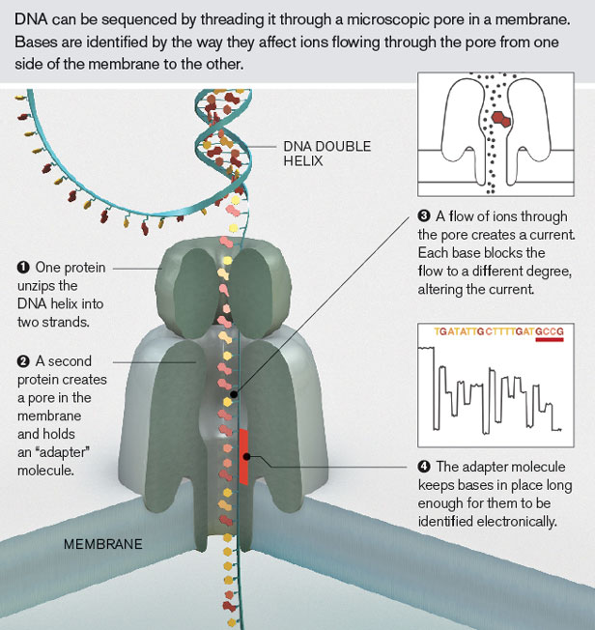
3rd Generation sequencing-Nanopore Sequencing
Determine the sequence of DNA fragments by passing DNA through a protein (or other) pore in a membrane
Notes:
Single molecule
Long read
Publicly available through select community starting April 2014

Slide 20
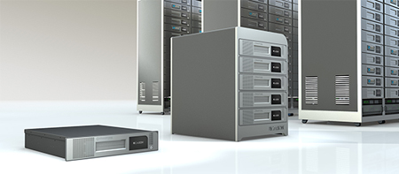
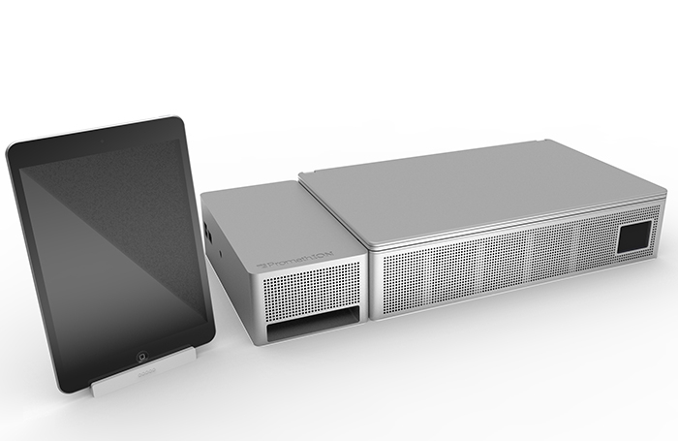
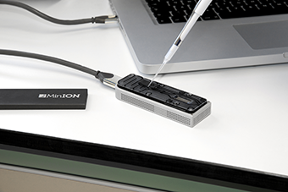
Nanopore
80,000+ bp. reads
MinION: 150 mill. Bp pr 6 h.
(30x coverage of E. coli)
GridION
MinION
PromethION
Notes:
38.2 % error rate on the MinION

Slide 21
Analysis of Sequenced Data
Analysis of sequenced data requires expertise in bioinformatics, computational biology, statistics, and molecular biology, as well as access to high-performance computing resources and bioinformatics software tools.
-a critical role in advancing our understanding of genomics, genetics, and biological processes, and facilitates discoveries in fields such as personalized medicine, agriculture, evolutionary biology, and beyond.

Slide 22
Typing and detection of AMR genes
Multilocus sequence typing (MLST) of S.aureus
from clinical samples
Antibiotic resistance genes

Slide 23
Molecular relatedness of pathogens
Detection of new pathogens
SNP-Phylogenetic tree (A.baumannii)

Slide 24
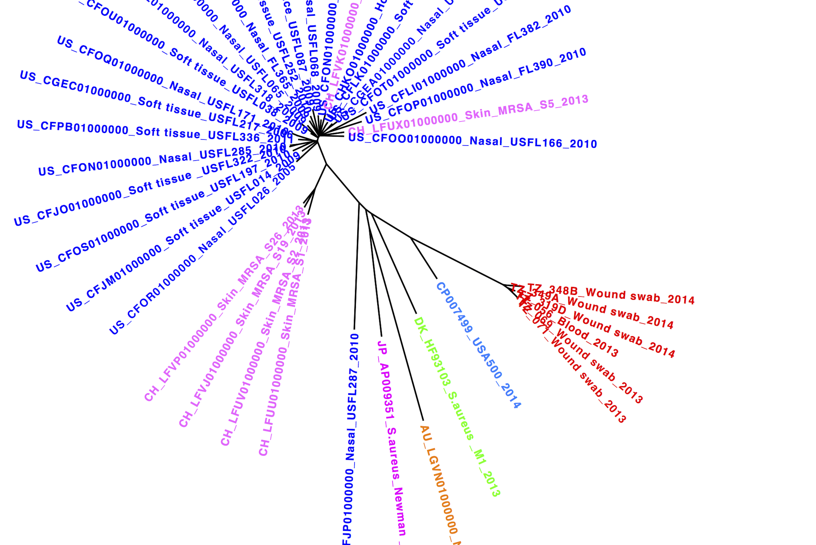
SNP-Phylogenetic tree
USA500_2395

Slide 25
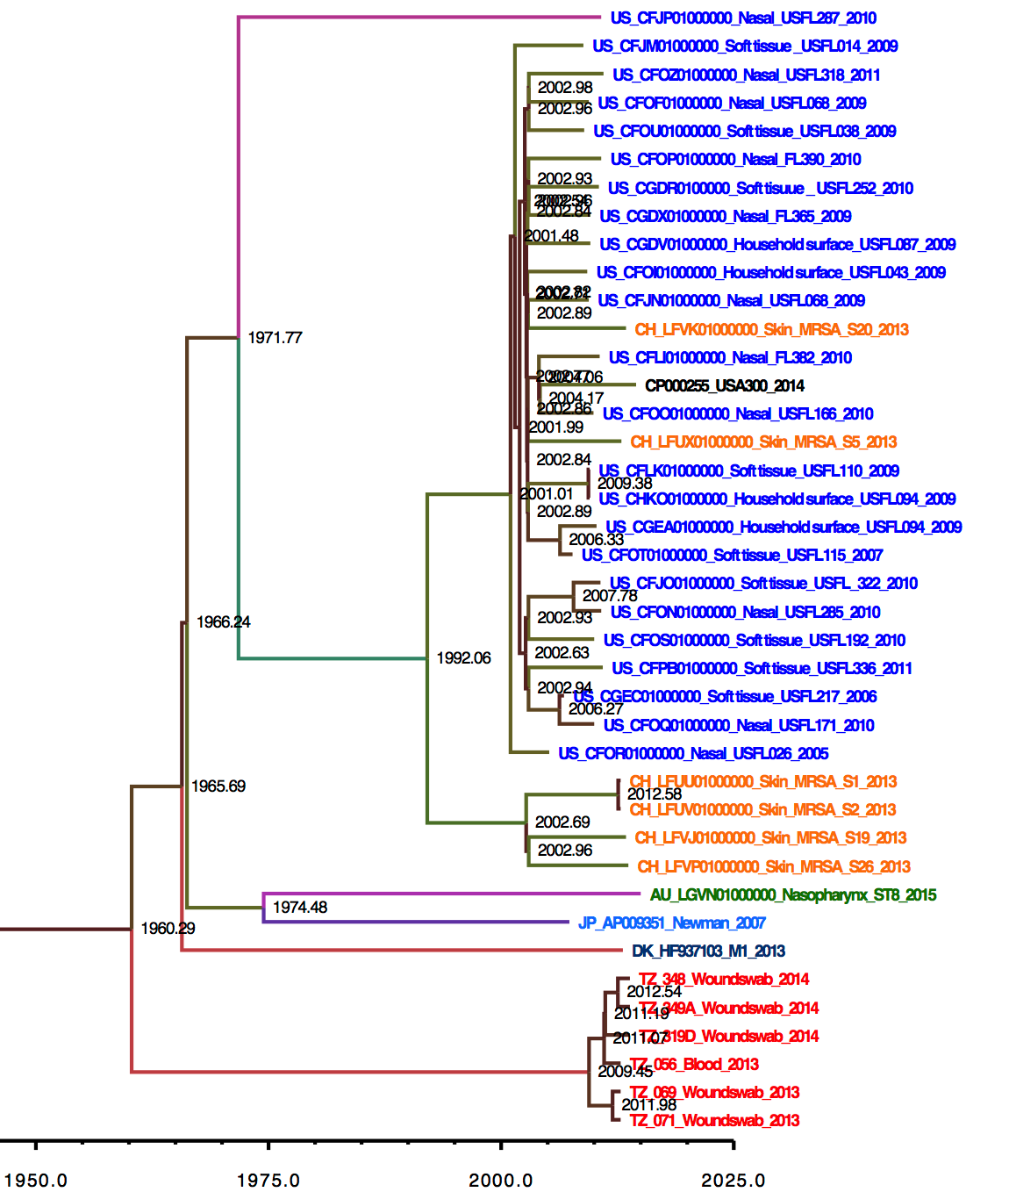
Bayesian Evolutionary Analysis Sampling Tree
1.4x10⁻⁶ SNPs/Site/year

Slide 26
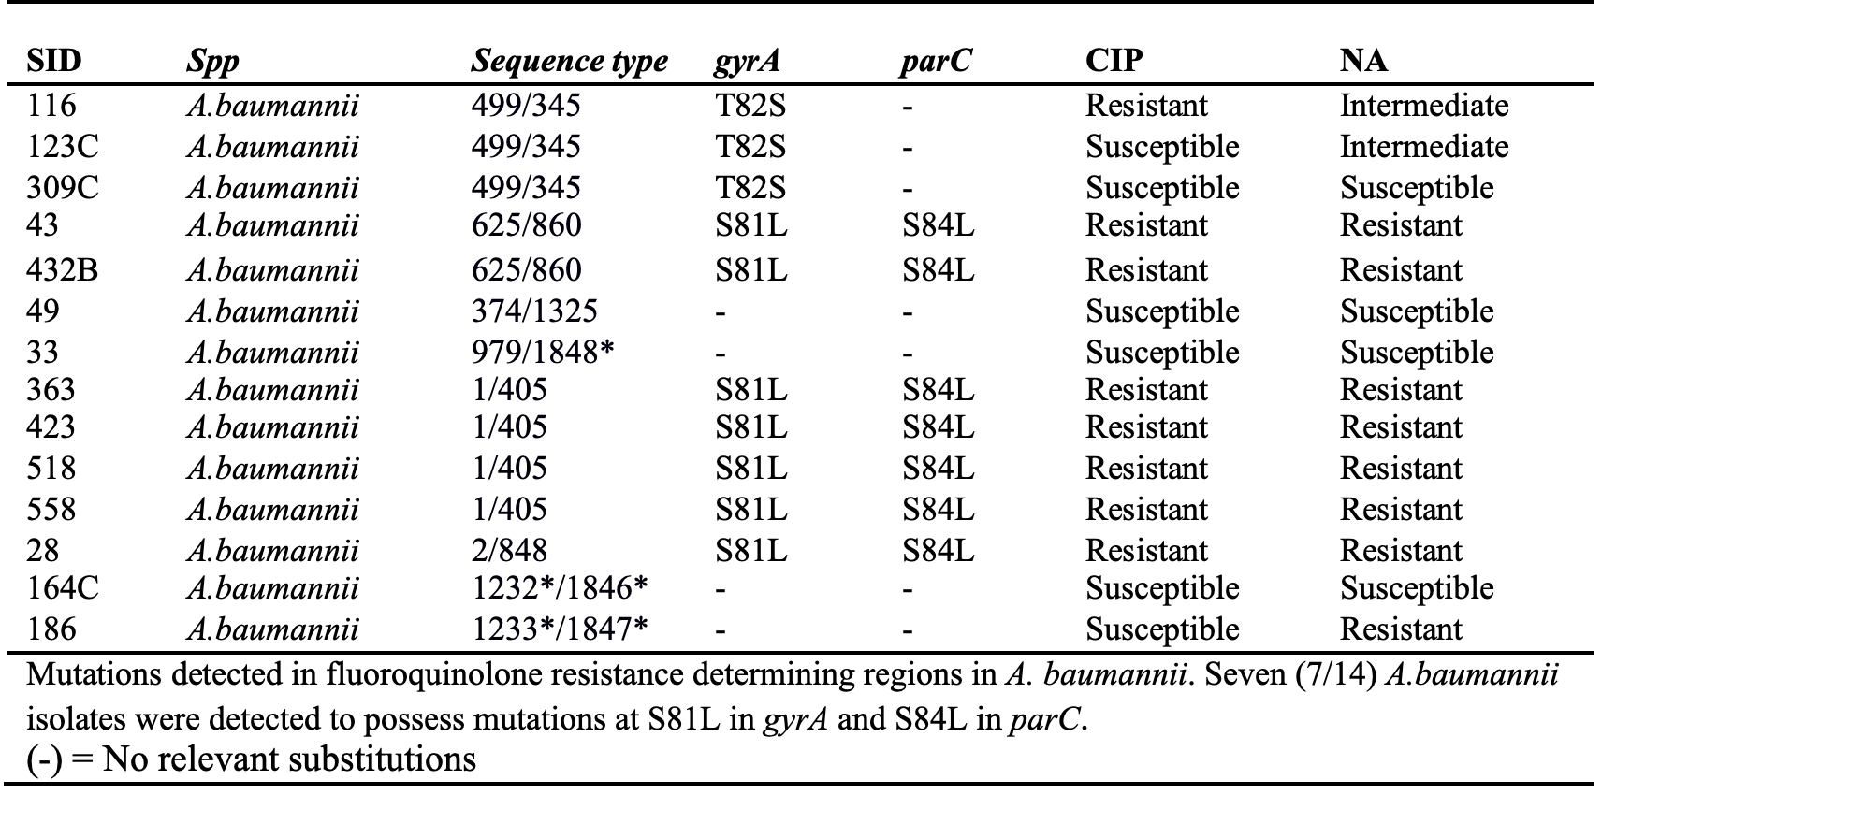
Mutations in fluoroquinolone resistance-determining genes

Slide 27
Prediction of phenotypes and % Agreement between Predicted and tested Resistance in 8 antibiotics
Percentages
Drugs

Slide 28
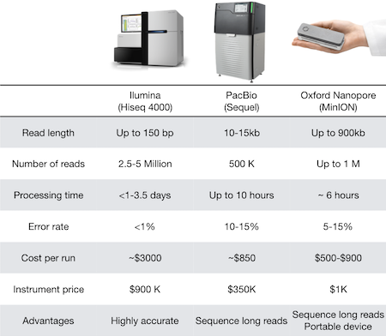
Notes:
They all have their distinct characteristics. Depending on the application, one technology may be better than others. And it’s not uncommon to sequence DNA with two techniques, to combine the strengths of both!

Slide 29
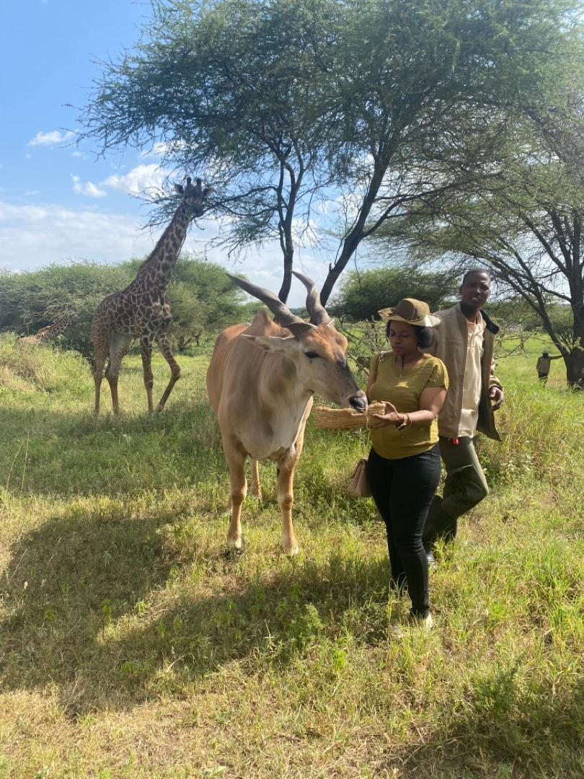
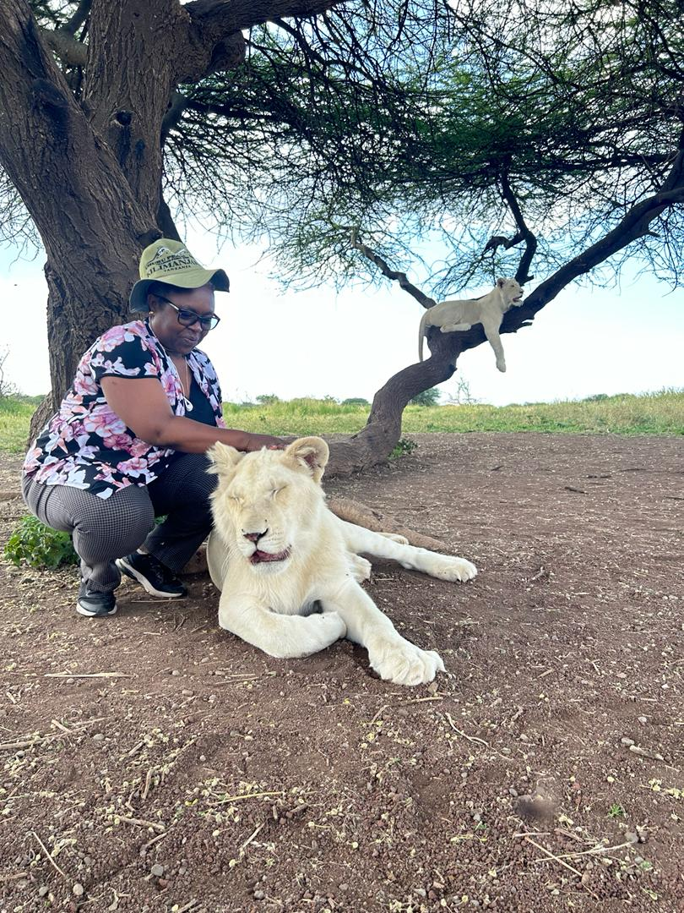
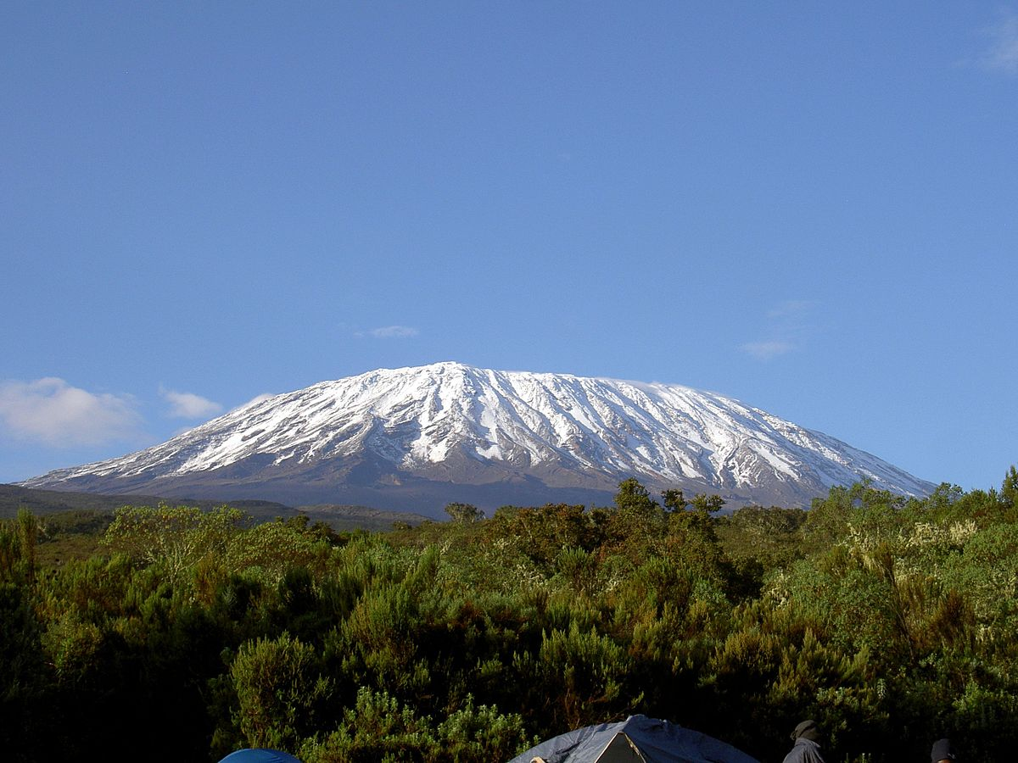
Thank you
Mt. Kilimanjaro
Serval Wild life –West Kilimanjaro
Serval Wild life –West Kilimanjaro

